Slide 1
Ethics in Research

Slide 2
Ethics
Research ethics concerns the responsibility of researchers to be honest and respectful to all individuals who are affected by their research studies or their reports of the studies’ results.

Slide 3
History

Slide 4
Unethical Examples
Breaking and re-breaking of bones ( to see how many times they could be broken before healing failed to occur) Nazi
Patients had been injected with live cancer cells (Jewish Chronic Disease Hospital, NY, 1963)
400 men had been left to suffer with syphilis long after a cure ( penicillin) was available. (Tuskegee, Alabama, 1932-72)
Milgram’s study sustained no physical harm, they suffered shame and embarrassment for having behaved inhumanely toward their fellow human beings.(1963)

Slide 5
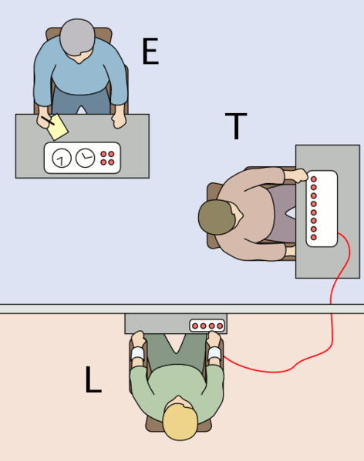
Milgram’s
Please continue.
The experiment requires that you continue.
It is absolutely essential that you continue.
You have no other choice, you must go on.

Slide 6
Ethics Codes
Notes:
‹#›

Slide 7
First Code
Nuremberg Code, a set of 10 guidelines for the ethical treatment of human participants in research. 1949

Slide 8
The Belmont Report
25 years later
National Research Act. 1974
The Belmont Report, 1979

Slide 9
The Belmont Report 1979
( 1) Individuals should consent to participate in studies and those who cannot give their consent, such as children, people with diminished abilities, and prisoners, need to be protected.
( 2) The researcher not harm the participants, minimize risks, and maximize possible benefits.
( 3) fairness in procedures for selecting participants.

Slide 10
APA Guide
The researcher is obligated to protect participants from physical or psychological harm.
During or after a study, participants may feel increased anxiety, anger, lower self- esteem, or mild depression, especially in situations in which they feel they have been cheated, tricked, deceived, or insulted.

Slide 11
Table 4.2 (APA guide)
The general concept of informed consent is that human participants should be given complete information about the research and their roles in it before agreeing to participate.

Slide 12
Clinical Equipoise

Slide 13
Clinical Equipoise
This means that a researcher can compare treatments when:
a. there is honest uncertainty about which treatment is best.
b. there is honest professional disagreement among experts concerning which treatment is best.

Slide 14
Explain why and ensure understanding
Researchers often tell participants exactly what will be done in the study but do not explain why.
Simply telling participants about the research does not necessarily mean they are informed, especially in situations in which the participants may not be competent enough to understand.

Slide 15
Voluntary Participation
Participants may feel coerced to participate or perceive that they have limited choice.

Slide 16
Deception
Passive deception ( or omission) is the withholding or omitting of information; the researcher intentionally does not tell participants some information about the study.
Active deception ( or commission) is the presenting of misinformation about the study to participants. The most common form of active deception is misleading participants about the specific purpose of the study.

Slide 17
Justified Deception
The deception must be justified in terms of some significant benefit that outweighs the risk to the participants. The researcher must consider all alternatives to deception and must justify the rejection of any alternative procedures.

Slide 18
Debriefing
The final point is that deceived participants must receive a debriefing that provides a full description of the true purpose of the study, including the use and purpose of deception, after the study is completed.

Slide 19
Confidentiality
The APA ethical guidelines require that researchers ensure the confidentiality of their research participants.
Ensuring that participants’ records are kept anonymous.

Slide 20
The Institutional Review Board
Each institution or agency is required to establish a committee called an Institutional Review Board ( IRB), which is composed of both scientists and nonscientists.

Slide 21
ETHICAL ISSUES AND SCIENTIFIC INTEGRITY

Slide 22
Reporting of Research
Researchers do not fabricate data. (They do not make false, deceptive, or fraudulent statements concerning their publications or research findings.)
If they discover significant errors in their published data, they take reasonable steps to correct such errors in a correction, re-traction, erratum, or other appropriate publication means.
They do not present portions of another’s work or data as their own, even if the other work or data source is cited occasionally.

Slide 23
Error and fraud
It is important to distinguish between error and fraud.
Fraud, is an explicit effort to falsify or misrepresent data.
Watch the video
Fredric Mishkin a full professor at Columbia Business School.

Slide 24
Safeguards Against Fraud

Slide 25
Safeguards Against Fraud
A safeguard against fraud is peer review, which takes place when a researcher submits a research article for publication.
Replication is repetition of a research study using the same basic procedures used in the original to test the accuracy.

Slide 26
Plagiarism
You can literally copy an entire paper word for word and present it as your own work or you can copy and paste passages from articles and sites found on the Internet.

Slide 27


Slide 28
What about
You may be inspired by someone’s ideas or influenced by the phrases someone used to express a concept.
After working on a project for an extended time, it can become difficult to separate your own words and ideas from those that come to you from outside sources. As a result, outside ideas and phrases can appear in your paper without appropriate citation.

Slide 29
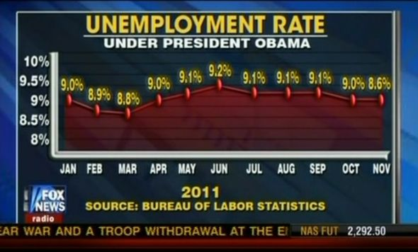
Misleading graphs

Slide 30
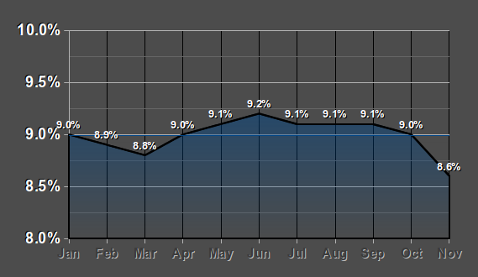

Slide 31
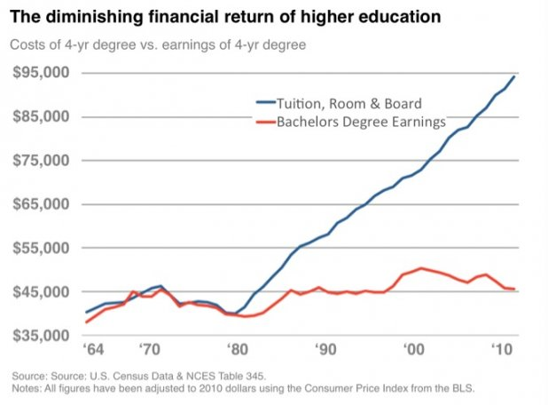
Notes:
No. David Blake read the chart without taking into account a key fact that wasn’t on the chart: the cost of not going to college has diminished even more. Than means, your prospects as a high school graduate are a lot worse than your prospects as a college graduate.
Another key piece of information is on the chart itself. Note the average yearly income a college grad can expect is about $45,000 in 2010. That’s per year. Over an average working lifetime (say, 43 years assuming retirement at age 65), that gives you an income of $45,000 * 43 = $1,935,000. Subtract that expensive college education ($95,000) and your net earnings are $1,840,000. Compare that to your average high school grad. They can expect to earn $1,300,000 over their lifetime (Source: The U.S. Department of Education). That’s quite a difference!
‹#›

Slide 32
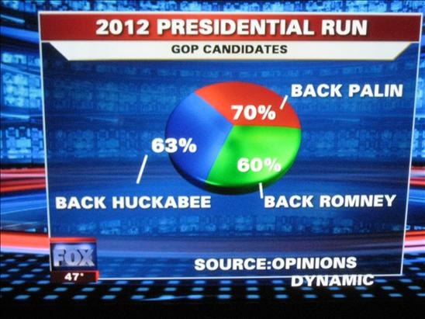
Notes:
Does not add up to 100
‹#›

Slide 33

And the Winner in the Misleading Graphs category is…

Slide 34
